Slide 1


Design of Quantum Algorithms: What Would You Do With a Working Quantum Computer?
Quantum computing holds immense potential. It promises breakthroughs across various fields.
-M. Goutham (22071A6793)
Notes:
1

Slide 2

Introduction to Quantum Computing
1
Qubit
2
Superposition
The fundamental unit of quantum information.
A qubit can be in multiple states at once.
3
Entanglement
Linked qubits share the same fate.
Notes:
2

Slide 3
Quantum Algorithms vs. Classical Algorithms
Classical
Quantum
Based on bits, 0 or 1.
Leverages superposition and entanglement.
Notes:
3

Slide 4




Shor's Algorithm for Factoring Large Numbers
Problem
Factor a large number.
Quantum Fourier Transform
Key step in the algorithm.
Solution
Factors are found quickly.
Notes:
4

Slide 5

Grover's Algorithm for Database Searching
1
Problem
Find a specific item.
2
Quantum Oracle
Marks the target item.
3
Amplification
Increases target probability.
4
Measurement
Finds the target item.
Notes:
5

Slide 6
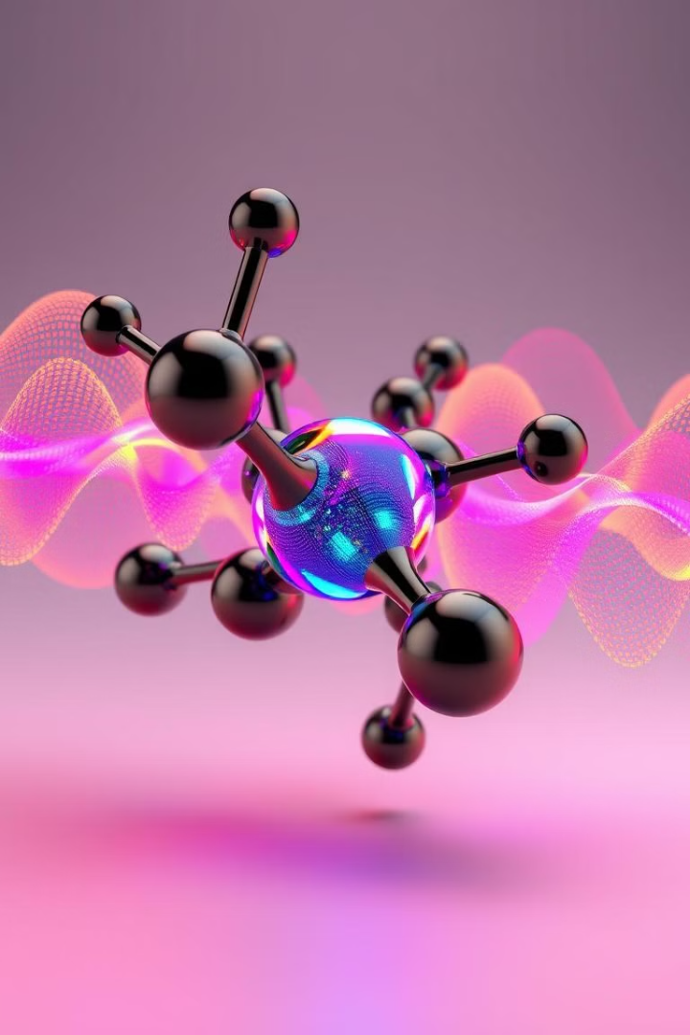
Quantum Simulation and Quantum Chemistry
Drug Discovery
Materials Science
Simulate molecules to design new drugs.
Design new materials with specific properties.
Notes:
6

Slide 7

Quantum Machine Learning and Artificial Intelligence
Classical ML
Quantum ML
Bits
Qubits
Limited parallelism
Exponential speedup potential
Notes:
7

Slide 8




The Future of Quantum Computing and Its Applications
Healthcare
Drug discovery and diagnostics.
Finance
Risk management and fraud detection.
Security
Unbreakable encryption.
Notes:
8

Slide 9

Conclusion
Quantum computing is rapidly advancing. Its potential is vast and transformative.
Notes:
9

